Slide 1
Topic 17
More on Arrays

Slide 2
Two-Dimensional Arrays
The arrays we have seen so far are known as
one-dimensional arrays.
There is basically just a list of data.
Many applications require data that is organized as a table i.e. with many rows and columns.
An array that is organized as a table is called a
two-dimensional array.

Slide 3
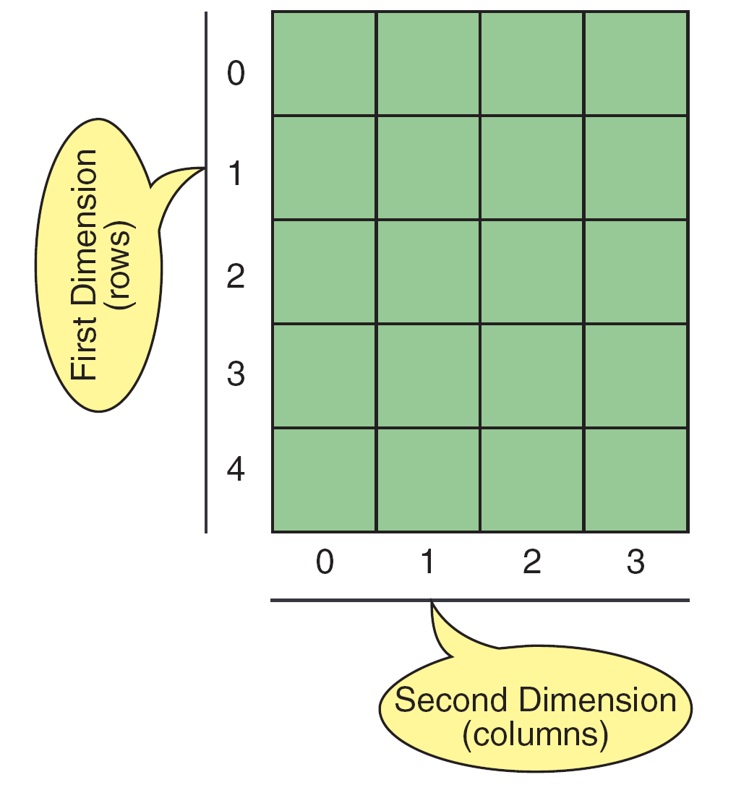
Two-Dimensional Arrays

Slide 4
Declaring a Two-Dimensional Array
To declare a two-dimensional array, we need to specify the
element type
array name
number of rows
number of columns
Example: int table[5][4];
This declares an array with the name table which has 5 rows and 4 columns, giving a total of 20 elements.
Note: all the elements are the same type.

Slide 5
Accessing Elements
To access the elements in the array, two indexes are needed.
The first index refers to the row and the second index refers to the column.
Example:
table[0][2] – refers to element in row 0 and column 2
table[4][3] – refers to element in row 4 and column 3
Example – assigning a value to an element:
table[0][2] = 23;

Slide 6
Two-Dimensional Arrays

Slide 7
Accessing Elements
Example: To print the values of the array in rows and columns format:
for (row = 0; row < 5; row++)
{
for (column = 0; column < 4; column++)
cout << setw(5) << table[row][column] ;
cout << endl;
}

Slide 8
Accessing Elements
If array table has values as shown:
The output will be as follows :
0 1 2 3
10 11 12 13
20 21 22 23
30 31 32 33
40 41 42 43

Slide 9
Accessing Elements
Example: To initialize the values of the array as shown:
for (row = 0; row < 5; row++)
for (column = 0; column < 4; column++)
table[row][column] = row * 10 + column;

Slide 10
Accessing Elements
Example: To read and store the values in the array.
for (row = 0; row < 5; row++)
for (column = 0; column < 4; column++)
cin >> table[row][column];

Slide 11
Array Initialization
The array can be initialized when it is defined:
int table [5][4] =
{
{ 0, 1, 2, 3 } ,
{ 10, 11, 12, 13 } ,
{ 20, 21, 21, 23 } ,
{ 30, 31, 32, 33 } ,
{ 40, 41, 42, 43 } ,
};

Slide 12
Passing Whole Array to Functions
When we pass a two-dimensional array to a function, we use the array name as the actual parameter, just like what we did for a one-dimensional array.
The formal parameter in the function header must indicate the array has two dimensions.
Example:
void display(int table[ ][4], int numRows)
Note: We do not need to specify the number of rows but we must specify the number of columns.

Slide 13
Case Study 1
Problem:
A company has sales data for the 4 quarters of the past 3 years. The company wants a report produced showing the sales for each quarter and the total sales for each year.
The format for the report should be as follows:
Sales (in millions)
Year Q1 Q2 Q3 Q4 Total
2009 2.57 1.31 1.78 2.01 xx.xx
2010 2.01 1.74 1.57 1.99 xx.xx
2011 2.65 1.80 1.89 2.23 xx.xx

Slide 14
Case Study 1
Design the solution:
We use a two-dimensional array to store the sales data.
Each row represents the sales data for a year.
Each column represents the sales data for a quarter.
double sales[3][4];
We use a one-dimensional array to store the totals for each year.
double total[3];

Slide 15
Case Study 1 – Complete Program
#include <iostream>
#define NUM_YEARS 3
#define NUM_QRTS 4
using namespace std;
void getTotal(double table[][NUM_QRTS],
double total[], int rows);
int main(void)
{
double sales[NUM_YEARS][NUM_QRTS];
double total[NUM_YEARS];
int startYear, year, qrt;

Slide 16
Case Study 1 – Complete Program
cout << "To process sales data for 3 years\n";
cout << "Please enter the start year:";
cin >> startYear;
for (year = 0; year < NUM_YEARS; year++)
{
cout << "Sales data for "
<< startYear + year << endl;
for (qrt = 0; qrt < NUM_QRTS; qrt++)
{
cout << "Enter for quarter "
<< qrt + 1 << ": ";
cin >> sales[year][qrt]);
}
}

Slide 17
Case Study 1 – Complete Program
getTotal(sales, total, NUM_YEARS);
cout << "\t\tSales (in millions)\n";
cout << "Year\t Q1\t Q2\t Q3\t Q4";
cout << "\tTotal\n";
for (year = 0; year < NUM_YEARS; year++)
{
cout << startYear + year;
for (qrt = 0; qrt < NUM_QRTS; qrt++)
cout << "\t" << sales[year][qrt]);
cout << "\t" << total[year] << endl;
}
return 0;
}

Slide 18
Case Study 1 – Complete Program
void getTotal(double table[][NUM_QRTS],
double total[], int rows)
{
for (int i = 0; i < rows; i++)
{
total[i] = 0.0;
for (int j = 0; j < NUM_QRTS; j++)
total[i] += table[i][j];
}
return;
}

Slide 19
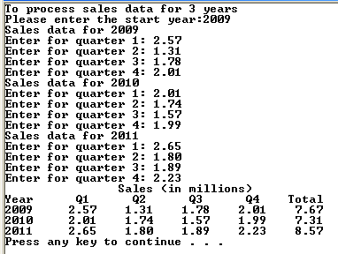
Case Study 1

Slide 20
Passing Array Elements to Functions
Example - Suppose we have a function as follows:
And a two-dimensional array as follows:
int scores[50][3]; // 3 test scores of 50 students
int isPass(int score)
{
if (score >= 50)
return true;
else
return false;
}

Slide 21
Passing Array Elements to Functions
Just as for one-dimensional arrays, you can pass an element to a function.
Example – to count number of tests with a pass:
int countPasses, student, test;
countPasses = 0;
for (student = 0; student < 50; student++)
for (test = 0; test < 3; test++)
if ( isPass( scores[student][test] ) )
countPasses++;

Slide 22
Passing Rows to Functions
Example – Suppose we have a function which finds the total of the values of a one-dimensional array:
int findTotal(int data[], int size)
{
int total;
total = 0;
for (int i = 0; i < size; i++)
total += data[i];
return total;
}

Slide 23
Passing Rows to Functions
For two-dimensional arrays, you can also pass a row of the array to a function.
int total[50];
int student, test;
for (student = 0; student < 50; student++)
total[student] = findTotal(scores[student], 3);

Slide 24
Multidimensional Arrays
Multidimensional arrays can have 3, 4 or more dimensions.
Declaring multidimensional arrays
Example – 3-dimensional array:
int table[3][5][4];

Slide 25
Multidimensional Arrays

